Slide 1
CODE OPTIMIZATION AND CODE GENERATION
Principal Sources of Optimization-DAG- Optimization of Basic Blocks-Global Data Flow Analysis - Efficient Data Flow Algorithms
Issues in Design of a Code Generator - A Simple Code Generator Algorithm. Case Study: Single pass and two pass compilers.

Slide 2
CODE OPTIMIZATION
The code produced by the straight forward compiling algorithms can often be made to run faster or take less space, or both.
This improvement is achieved by program transformations that are traditionally called optimizations.
Compilers that apply code-improving transformations are called optimizing compilers.

Slide 3
Optimizations are classified into two categories.
They are
• Machine independent optimizations:
• Machine dependant optimizations:
Machine independent optimizations:
• Machine independent optimizations are program transformations that improve the target code without taking into consideration any properties of the target machine.
Machine dependant optimizations:
• Machine dependant optimizations are based on register allocation and utilization of special machine-instruction sequences.

Slide 4
PRINCIPAL SOURCES OF OPTIMISATION
A transformation of a program is called local if it can be performed by looking only at the statements in a basic block; otherwise, it is called global.
Many transformations can be performed at both the local and global levels.
Local transformations are usually performed first.
Function-Preserving Transformations
There are a number of ways in which a compiler can improve a program without changing the function it computes.

Slide 5
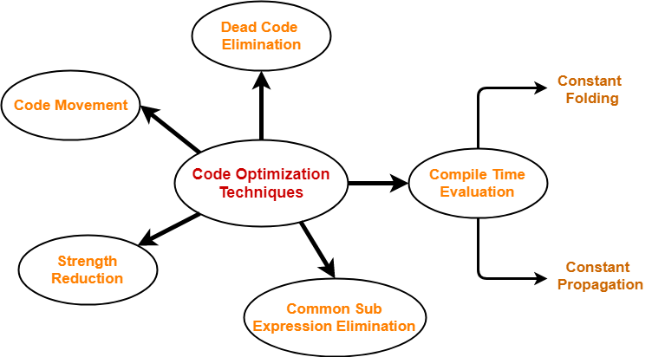

Slide 6
Common Sub expressions elimination:
An occurrence of an expression E is called a common sub-expression if E was previously computed, and the values of variables in E have not changed since the previous computation. We can avoid recomputing the expression if we can use the previously computed value.
• For example
t1: = 4*i
t2: = a [t1]
t3: = 4*j
t4: = 4*i
t5: = n
t6: = b [t4] +t5
The above code can be optimized using the common sub-expression elimination as
t1: = 4*i
t2: = a [t1]
t3: = 4*j
t5: = n
t6: = b [t1] +t5
The common sub expression t4: =4*i is eliminated as its computation is already in t1 and the value of i is not been changed from definition to use.

Slide 7
Copy Propagation:
Assignments of the form f : = g called copy statements, or copies for short. The idea behind the copy-propagation transformation is to use g for f, whenever possible after the copy statement f: = g.
Copy propagation means use of one variable instead of another. This may not appear to be an improvement, but as we shall see it gives us an opportunity to eliminate x.
• For example:
x=Pi;
A=x*r*r;
The optimization using copy propagation can be done as follows: A=Pi*r*r;
Here the variable x is eliminated

Slide 8
Constant folding:
Deducing at compile time that the value of an expression is a constant and using the constant instead is known as constant folding.
One advantage of copy propagation is that it often turns the copy statement into dead code.
For example,
a=3.14157/2 can be replaced by
a=1.570 there by eliminating a division operation.

Slide 9
Dead-Code Eliminations:
A variable is live at a point in a program if its value can be used subsequently; otherwise, it is dead at that point.
A related idea is dead or useless code, statements that compute values that never get used.
While the programmer is unlikely to introduce any dead code intentionally, it may appear as the result of previous transformations.
Example:
i=0;
if(i=1)
{
a=b+5;
}
Here, ‘if’ statement is dead code because this condition will never get satisfied.

Slide 10
Code Movement
In this technique,
As the name suggests, it involves movement of the code.
The code present inside the loop is moved out if it does not matter whether it is present inside or outside.
Such a code unnecessarily gets execute again and again with each iteration of the loop.
This leads to the wastage of time at run time.
Code Before Optimization
for ( int j = 0 ; j < n ; j ++)
{
x = y + z ;
a[j] = 6 x j;
}
Code After Optimization
x = y + z ;
for ( int j = 0 ; j < n ; j ++)
{
a[j] = 6 x j;
}

Slide 11
Strength Reduction-
In this technique,
As the name suggests, it involves reducing the strength of expressions.
This technique replaces the expensive and costly operators with the simple and cheaper ones.
Example-
Code Before Optimization
B = A x 2
Code After Optimization
B = A + A
Here,
The expression “A x 2” is replaced with the expression “A + A”.
This is because the cost of multiplication operator is higher than that of addition operator.

Slide 12
Basic Blocks-
Basic block is a set of statements that always executes in a sequence one after the other.
The characteristics of basic blocks are-
They do not contain any kind of jump statements in them.
There is no possibility of branching or getting halt in the middle.
All the statements execute in the same order they appear.
They do not lose lose the flow control of the program.

Slide 13
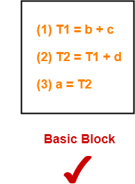
Example Of Basic Block-
Three Address Code for the expression a = b + c + d is-
Here,
All the statements execute in a sequence one after the other.
Thus, they form a basic block.

Slide 14
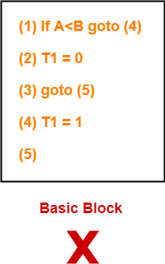
Example Of Not A Basic Block-
Three Address Code for the expression If A<B then 1 else 0 is-
Here,
The statements do not execute in a sequence one after the other.
Thus, they do not form a basic block.

Slide 15
Partitioning Intermediate Code Into Basic Blocks-
Any given code can be partitioned into basic blocks using the following rules-
Rule-01: Determining Leaders-
Following statements of the code are called as Leaders–
First statement of the code.
Statement that is a target of the conditional or unconditional goto statement.
Statement that appears immediately after a goto statement.
Rule-02: Determining Basic Blocks-
All the statements that follow the leader (including the leader) till the next leader appears form one basic block.
The first statement of the code is called as the first leader.
The block containing the first leader is called as Initial block.

Slide 16
Flow Graphs-
A flow graph is a directed graph with flow control information added to the basic blocks.
The basic blocks serve as nodes of the flow graph.
There is a directed edge from block B1 to block B2 if B2 appears immediately after B1 in the code

Slide 17
Example
Compute the basic blocks for the given three address statements-
(1) PROD = 0
(2) I = 1
(3) T2 = addr(A) – 4
(4) T4 = addr(B) – 4
(5) T1 = 4 x I
(6) T3 = T2[T1]
(7) T5 = T4[T1]
(8) T6 = T3 x T5
(9) PROD = PROD + T6
(10) I = I + 1
(11) IF I <=20 GOTO (5)
We have-
PROD = 0 is a leader since first statement of the code is a leader.
T1 = 4 x I is a leader since target of the conditional goto statement is a leader.
Now, the given code can be partitioned into two basic blocks as-

Slide 18
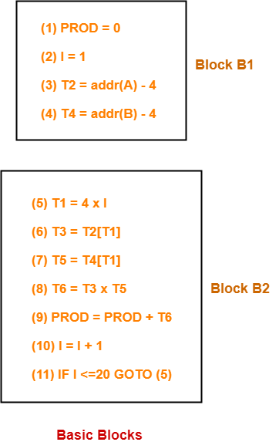

Slide 19
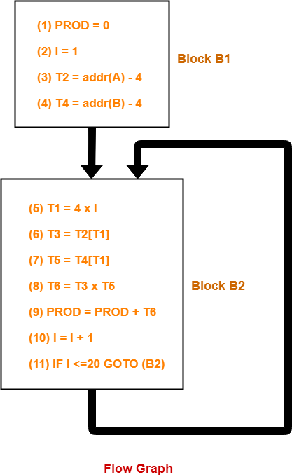
Draw a flow graph for the three address statements given in example above.

Slide 20
Directed Acyclic Graph
Directed Acyclic Graph (DAG) is a tool that depicts the structure of basic blocks, helps to see the flow of values flowing among the basic blocks, and offers optimization too. DAG provides easy transformation on basic blocks. DAG can be understood here:
Leaf nodes represent identifiers, names or constants.
Interior nodes represent operators.
Interior nodes also represent the results of expressions or the identifiers/name where the values are to be stored or assigned.
Example:
t₀ = a + b
t₁ = t₀ + c
d = t₀ + t₁

Slide 21

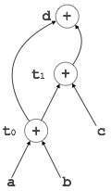
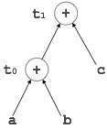
[t₀ = a + b]
[d = t₀ + t₁]
[t₁ = t₀ + c]

Slide 22
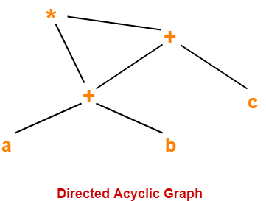
Consider the following expression and construct a DAG for it-
( a + b ) x ( a + b + c )
Three Address Code for the given expression is-
T1 = a + b
T2 = T1 + c
T3 = T1 x T2

Slide 23
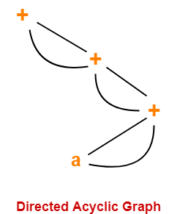
Consider the following expression and construct a DAG for it-
( ( ( a + a ) + ( a + a ) ) + ( ( a + a ) + ( a + a ) ) )

Slide 24
APPLICATION OF DAGs
DAGs are used for the following purposes-
To determine the expressions which have been computed more than once (called common sub-expressions).
To determine the names whose computation has been done outside the block but used inside the block.
To determine the statements of the block whose computed value can be made available outside the block.

Slide 25
OPTIMIZATION OF BASIC BLOCKS
There are two types of basic block optimizations. They are :
Ø Structure-Preserving Transformations
Ø Algebraic Transformations
Structure-Preserving Transformations:
The primary Structure-Preserving Transformation on basic blocks are:
Ø Common sub-expression elimination
Ø Dead code elimination
Ø Renaming of temporary variables
Ø Interchange of two independent adjacent statements

Slide 26
Common sub-expression elimination:
Common sub expressions need not be computed over and over again. Instead they can be computed once and kept in store from where it’s referenced.
Example:
a: =b+c
b: =a-d
c: =b+c
d: =a-d
The 2nd and 4th statements compute the same expression: b+c and a-d
Basic block can be transformed to
a: = b+c
b: = a-d
c: = a
d: = b

Slide 27
Dead code elimination:
It is possible that a large amount of dead (useless) code may exist in the program. This might be especially caused when introducing variables and procedures as part of construction or error-correction of a program - once declared and defined, one forgets to remove them in case they serve no purpose. Eliminating these will definitely optimize the code.
Renaming of temporary variables:
A statement t:=b+c where t is a temporary name can be changed to u:=b+c where u is another temporary name, and change all uses of t to u. In this a basic block is transformed to its equivalent block called normal-form block.
Interchange of two independent adjacent statements:
• Two statements
t1:=b+c
t2:=x+y
can be interchanged or reordered in its computation in the basic block when value of t1 does not affect the value of t2.

Slide 28
Algebraic Transformations:
This includes simplifying expressions or replacing expensive operation by cheaper ones i.e. reduction in strength.
Another class of related optimizations is constant folding. Here we evaluate constant expressions at compile time and replace the constant expressions by their values. Thus the expression 2*3.14 would be replaced by 6.28.
The relational operators <=, >=, <, >, + and = sometimes generate unexpected common sub expressions. Associative laws may also be applied to expose common sub expressions. For example, if the source code has the assignments
a :=b+c
e :=c+d+b
the following intermediate code may be generated: a :=b+c
t :=c+d e :=t+b

Slide 29
Example:
x:=x+0 =0+ x can be removed
X-0 = X
X*1 = 1*X = X
X/1 = X
x:=y**2 can be replaced by a cheaper statement x:=y*y
x/2 = x*0.5
The compiler writer should examine the language specification carefully to determine what rearrangements of computations are permitted, since computer arithmetic does not always obey the algebraic identities of mathematics.
Thus, a compiler may evaluate x*y-x*z as x*(y-z) but it may not evaluate a+(b-c) as (a+b)-c.

Slide 30
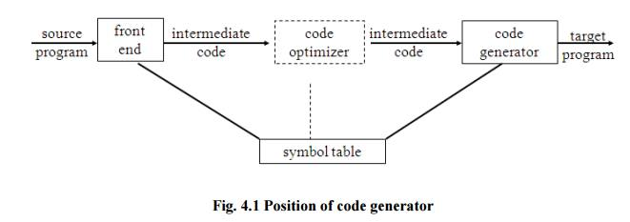
CODE GENERATION
The final phase in compiler model is the code generator. It takes as input an intermediate representation of the source program and produces as output an equivalent target program. The code generation techniques presented below can be used whether or not an optimizing phase occurs before code generation.

Slide 31
ISSUES IN THE DESIGN OF A CODE GENERATOR
The following issues arise during the code generation phase:
1. Input to code generator
2. Target program
3. Memory management
4. Instruction selection
5. Register allocation
6. Evaluation order

Slide 32
1. Input to code generator:
The input to the code generation consists of the intermediate representation of the source program produced by front end , together with information in the symbol table to determine run-time addresses of the data objects denoted by the names in the intermediate representation.
• Intermediate representation can be :
a. Linear representation such as postfix notation
b. Three address representation such as quadruples
c. Virtual machine representation such as stack machine code
d. Graphical representations such as syntax trees and DAGs.
Prior to code generation, the front end must be scanned, parsed and translated into intermediate representation along with necessary type checking. Therefore, input to code generation is assumed to be error-free.

Slide 33
2. Target program:
The output of the code generator is the target program.
The output may be :
a. Absolute machine language
- It can be placed in a fixed memory location and can be executed immediately.
b. Relocatable machine language
- It allows subprograms to be compiled separately.
c. Assembly language
- Code generation is made easier.

Slide 34
3. Memory management:
Names in the source program are mapped to addresses of data objects in run-time memory by the front end and code generator.
It makes use of symbol table, that is, a name in a three-address statement refers to a symbol-table entry for the name.
Labels in three-address statements have to be converted to addresses of instructions. For example,
j: goto i generates jump instruction as follows:
if i < j, a backward jump instruction with target address equal to location of code for quadruple i is generated.
if i > j, the jump is forward. We must store on a list for quadruple i the location of the first machine instruction generated for quadruple j.
When i is processed, the machine locations for all instructions that forward jumps to i are filled.

Slide 35
4. Instruction selection:
The instructions of target machine should be complete and uniform.
Instruction speeds and machine idioms are important factors when efficiency of target program is considered.
The quality of the generated code is determined by its speed and size.
The former statement can be translated into the latter statement as shown below:
a:=b+c
d:=a+e
MOV b,R0
ADD c,R0
MOV R0,a
MOV a,R0
ADD e,R0
MOV R0,d

Slide 36
5. Register allocation
Instructions involving register operands are shorter and faster than those involving operands in memory. The use of registers is subdivided into two sub problems :
1. Register allocation - the set of variables that will reside in registers at a point in the program is selected.
2. Register assignment - the specific register that a value picked
Certain machine requires even-odd register pairs for some operands and results.
For example , consider the division instruction of the form :D x, y
where, x - dividend even register /odd register pair y-divisor
even register holds the remainder
odd register holds the quotient

Slide 37
6. Evaluation order
The order in which the computations are performed can affect the efficiency of the target code.
Some computation orders require fewer registers to hold intermediate results than others.

Slide 38
A code-generation algorithm:
The algorithm takes as input a sequence of three-address statements constituting a basic block. For each three-address statement of the form x : = y op z, perform the following actions:
1. Invoke a function getreg to determine the location L where the result of the computation y op z should be stored.
2. Consult the address descriptor for y to determine y’, the current location of y. Prefer the register for y’ if the value of y is currently both in memory and a register. If the value of y is not already in L, generate the instruction MOV y’ , L to place a copy of y in L.

Slide 39
3. Generate the instruction OP z’ , L where z’ is a current location of z. Prefer a register to a memory location if z is in both. Update the address descriptor of x to indicate that x is in location L. If x is in L, update its descriptor and remove x from all other descriptors.
4. If the current values of y or z have no next uses, are not live on exit from the block, and are in registers, alter the register descriptor to indicate that, after execution of x : = y op z , those registers will no longer contain y or z

Slide 40
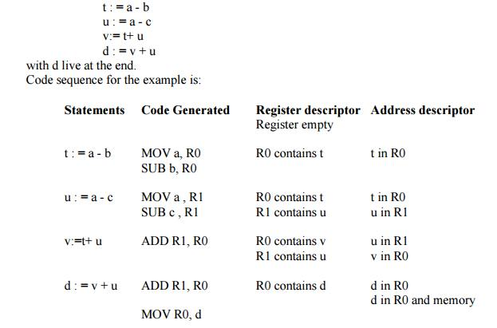
Generating Code for Assignment Statements:
The assignment d : = (a-b) + (a-c) + (a-c) might be translated into the following three-address code sequence:

Slide 41

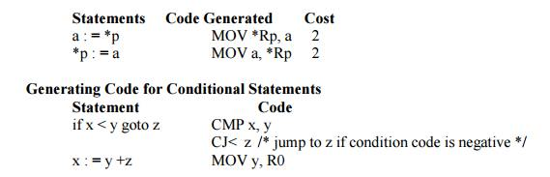
Generating Code for Indexed Assignments
The table shows the code sequences generated for the indexed assignment a:= b[ i ] and a[ i ]:= b
Generating Code for Pointer Assignments
The table shows the code sequences generated for the pointer assignments
a : = *p and *p : = a
if x < 0 goto z
ADD z, R0
MOV R0,x
CJ< z

Slide 42
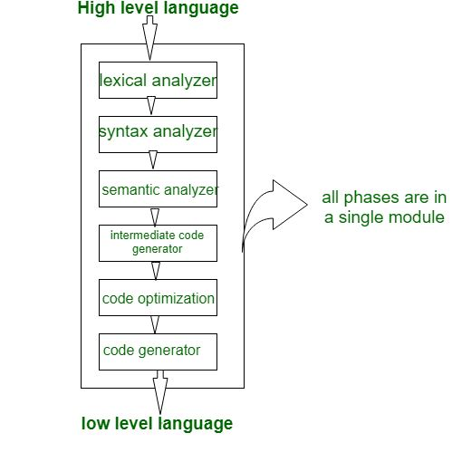
Single pass, Two pass, and Multi pass Compilers
A Compiler pass refers to the traversal of a compiler through the entire program. Compiler pass are two types: Single Pass Compiler, and Two Pass Compiler or Multi Pass Compiler. These are explained as following below.
1. Single Pass Compiler: If we combine or group all the phases of compiler design in a single module known as single pass compiler.

Slide 43
A one pass/single pass compiler is that type of compiler that passes through the part of each compilation unit exactly once.
Single pass compiler is faster and smaller than the multi pass compiler.
As a disadvantage of single pass compiler is that it is less efficient in comparison with multipass compiler.
Single pass compiler is one that processes the input exactly once, so going directly from lexical analysis to code generator, and then going back for the next read.
Note: Single pass compiler almost never done, early Pascal compiler did this as an introduction.

Slide 44
Problems with single pass compiler:
We can not optimize very well due to the context of expressions are limited.
As we can’t backup and process, it again so grammar should be limited or simplified.
Command interpreters such as bash/sh/tcsh can be considered as Single pass compiler, but they also execute entry as soon as they are processed.

Slide 45
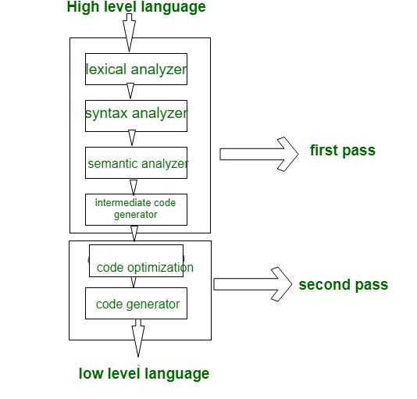
2. Two Pass compiler or Multi Pass compiler: A Two pass/multi-pass Compiler is a type of compiler that processes the source code or abstract syntax tree of a program multiple times. In multipass Compiler we divide phases in two pass as:

Slide 46
First Pass: is refers as
(a). Front end
(b). Analytic part
(c). Platform independent
In first pass the included phases are as Lexical analyzer, syntax analyzer, semantic analyzer, intermediate code generator are work as front end and analytic part means all phases analyze the High level language and convert them three address code and first pass is platform independent because the output of first pass is as three address code which is useful for every system and the requirement is to change the code optimization and code generator phase which are comes to the second pass.

Slide 47
Second Pass: is refers as
(a). Back end
(b). Synthesis Part
(c). Platform Dependent
In second Pass the included phases are as Code optimization and Code generator are work as back end and the synthesis part refers to taking input as three address code and convert them into Low level language/assembly language and second pass is platform dependent because final stage of a typical compiler converts the intermediate representation of program into an executable set of instructions which is dependent on the system.

Slide 48
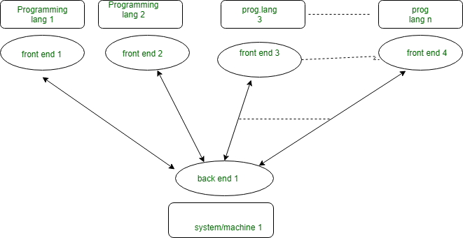
With multi-pass Compiler we can solve these 2 basic problems:
If we want to design a compiler for different programming language for same machine. In this case for each programming language there is requirement of making Front end/first pass for each of them and only one Back end/second pass as:
If we want to design a compiler for same programming language for different machine/system. In this case we make different Back end for different Machine/system and make only one Front end for same programming language as:

Slide 49
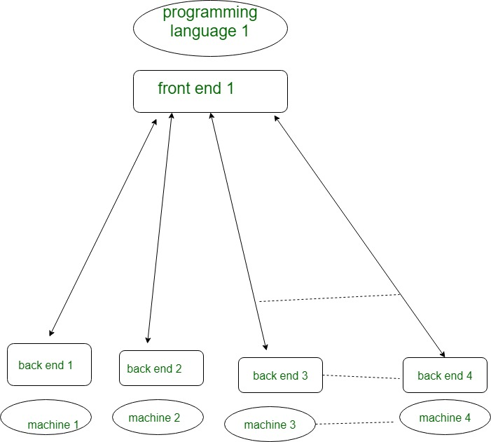

Slide 50
Differences between Single Pass and Multipass Compilers:
Parameters | Single pass | multi Pass
Speed | Fast | Slow
Memory | More | Less
Time | Less | More
Portability | No | Yes

Slide 51
INTRODUCTION TO GLOBAL DATAFLOW ANALYSIS
In order to do code optimization and a good job of code generation , compiler needs to collect information about the program as a whole and to distribute this information to each block in the flow graph.
A compiler could take advantage of “reaching definitions” , such as knowing where a variable like debug was last defined before reaching a given block, in order to perform transformations are just a few examples of data-flow information that an optimizing compiler collects by a process known as data-flow analysis.

Slide 52
Data-flow information can be collected by setting up and solving systems of equations of the form :
out [S] = gen [S] U ( in [S] - kill [S] )
This equation can be read as “ the information at the end of a statement is either generated within the statement , or enters at the beginning and is not killed as control flows through the statement.” Such equations are called data-flow equation.

Slide 53
1)The details of how data-flow equations are set and solved depend on three factors. The notions of generating and killing depend on the desired information, i.e., on the data flow analysis problem to be solved. Moreover, for some problems, instead of proceeding along with flow of control and defining out[S] in terms of in[S], we need to proceed backwards and define in[S] in terms of out[S].
2)Since data flows along control paths, data-flow analysis is affected by the constructs in a program. In fact, when we write out[s] we implicitly assume that there is unique end point where control leaves the statement; in general, equations are set up at the level of basic blocks rather than statements, because blocks do have unique end points.
3)There are subtleties that go along with such statements as procedure calls, assignments through pointer variables, and even assignments to array variables.

Slide 54
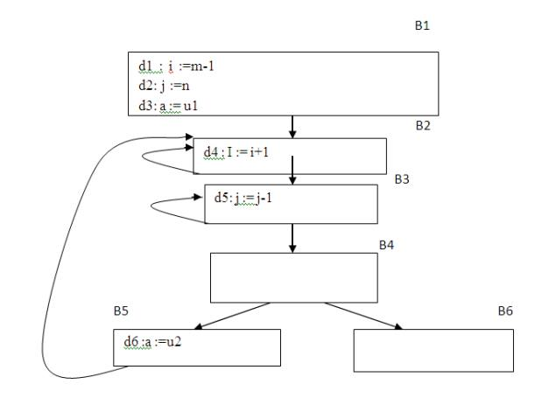
Points and Paths:
Within a basic block, we talk of the point between two adjacent statements, as well as the point before the first statement and after the last. Thus, block B1 has four points: one before any of the assignments and one after each of the three assignments.
Fig. 5.6 A flow graph

Slide 55
Now let us take a global view and consider all the points in all the blocks. A path from p1 to pn is a sequence of points p1, p2,….,pn such that for each i between 1 and n-1, either
1. Pi is the point immediately preceding a statement and pi+1 is the point immediately following that statement in the same block, or
2. Pi is the end of some block and pi+1 is the beginning of a successor block.

Slide 56
Reaching definitions:
A definition of variable x is a statement that assigns, or may assign, a value to x. The most common forms of definition are assignments to x and statements that read a value from an i/o device and store it in x. These statements certainly define a value for x, and they are referred to as unambiguous definitions of x. There are certain kinds of statements that may define a value for x; they are called ambiguous definitions.

Slide 57
The most usual forms of ambiguous definitions of x are:
1. A call of a procedure with x as a parameter or a procedure that can access x because x is in the scope of the procedure.
2. An assignment through a pointer that could refer to x. For example, the assignment *q:=y is a definition of x if it is possible that q points to x. we must assume that an assignment through a pointer is a definition of every variable.
We say a definition d reaches a point p if there is a path from the point immediately following d to p, such that d is not “killed” along that path. Thus a point can be reached by an unambiguous definition and an ambiguous definition of the appearing later along one path.

Slide 58
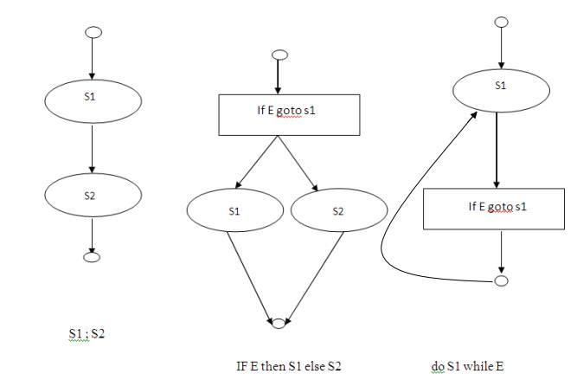
Some structured control constructs

